Slide 1
Embedded Track #1
Rules of the Game

Slide 2
Production costs
Production costs is the sum of development costs plus the cost of production.
The development costs is sometimes called the non recurring costs.
Number of IOT systems we are producing maybe on the order of 10’s.
For example, if a board layout cost are $1000 dollars, then the recurring cost for the board for a unit of 10 unit is $100.00.
This does not include populating the board
This does not include the costs of the pc board or the costs of the parts
The costs of parts can be 3X the cost of a large volume producer
One of the reason low volume systems in America are made in China
Also, the hardware costs have to multiplied by 3X to a customer for sustainable environment.
This means that we could be at a 9x cost advantage to a large manufacturer
Conclusion
We cannot do things the conventional way
Many of my lost friends have not made the transition

Slide 3
Hacking won’t work either
Hacking can produce a single unit but with problems.
Lots of jumper wires
Lots of manual labor
Lots of debugging to get it to work
In essence not very reproduceable

Slide 4
What are the solutions?
We need to be able to produce 100 units.
After 100 units, capital can be raised to redesign the unit to lower costs and reduce assembly costs.
Requirements
Need to assemble 100 units in a garage.
Minimal Capital Equipment
Laptop
Voltmeter
Low cost soldering station
Low cost test setups
Misc mechanical tools

Slide 5
SCADA, (PLC) is one Solution Raspberry PI is controller to PLC
SCADA solution requires little hardware NRE.
Low cost SCADA equipment can be purchased at
www.automationdirect.com
SCADA equipment is usually FCC and UL approved.
Low cost plc’s are price competitive
Terminal Blocks and other wiring solutions are available to handle the wiring complexity
The IOT systems usually involve systems less than 48 volts.
Should not require a PE license to field these systems.
My farm irrigation system is based upon a SCADA type solution.
Took me several years to realize this.
The assembly process involves being a low grade electronic cabinet assembler.

Slide 6
What about other approaches
The SCADA approach is effective for switching relays and discrete I/O.
SCADA approach has limitations.
Limited Analog Processing
Analog Capability is expensive.
PLC’s go from $80 to $200 range.
I2C and SPI devices are required.
We need to produce modules and wiring solutions which are reproduceable and reasonably cheap.

Slide 7
Rule #1 3X Markup
Do not apply the 3X Markup to hardware items that are purchased.
Many companies collapsed under that rule.
Corollary
Only develop what is required.
Find bread boards which can be used for multirole purposes.
Two examples are shown in the following pages.

Slide 8
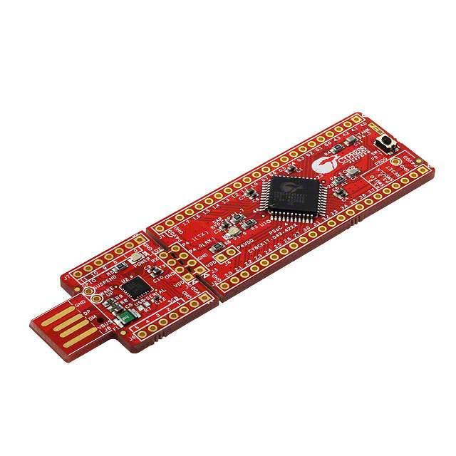
PSOC 4
The PSOC 4 is less than $5.00 from arrow ( orders over $20.00 ship overnight free)
For units over 1000 the price is $3.50 from Cypress.
Free Development tools from cypress.

Slide 9
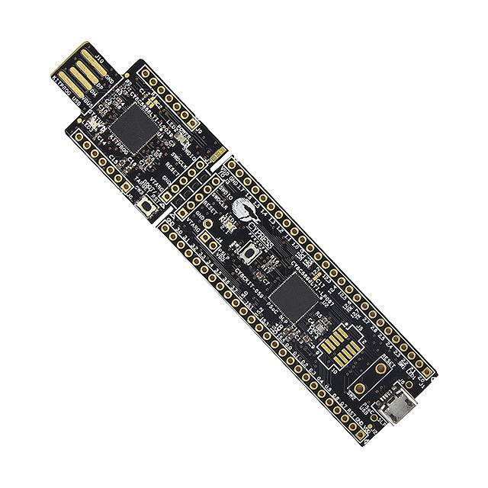
PSOC 5
This part has 4 instrumentation amplifiers and a high resolution a/d up to 18 bits. Also, the part has 4 DACS. Use this part when instrumentation situations arise.
The price of the part is $15.00 from Digi Key and $9.20 from Arrow.

Slide 10
Connections
Prototyping
Bread Board
IOT
Controller
I2c
PSOC
Module
Connectors

Slide 11
Unique Abilities of PSOC Modules
The I/O within reason can be programmed to different pin types.
It is possible to have the same board be configured to do many roles.
Makes it easier to develop a pcb for low volume applications.

Slide 12
Enclosures

